Slide 1
Information Technology Fundamentals
DT228/1
Tutorial 1 - IT History
Thursday 29 September 2016

Slide 2
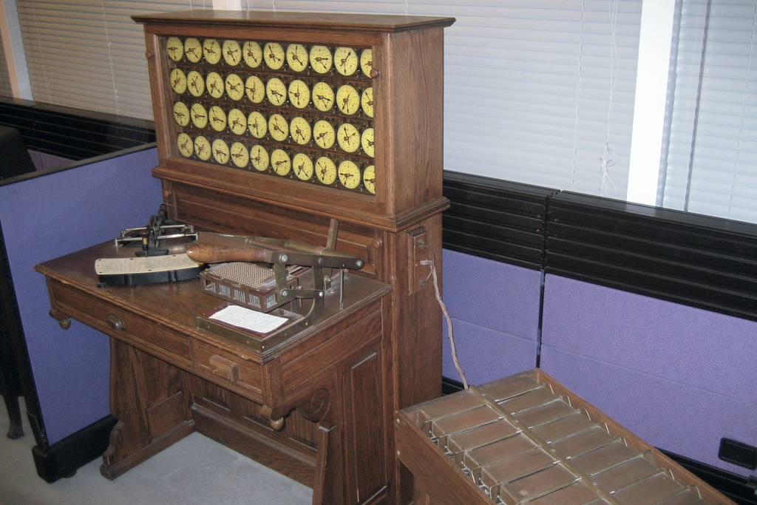
Add-On From This Week’s Lecture
Herman Hollerith’s 1890 tabulating machine and sorting box

Slide 3
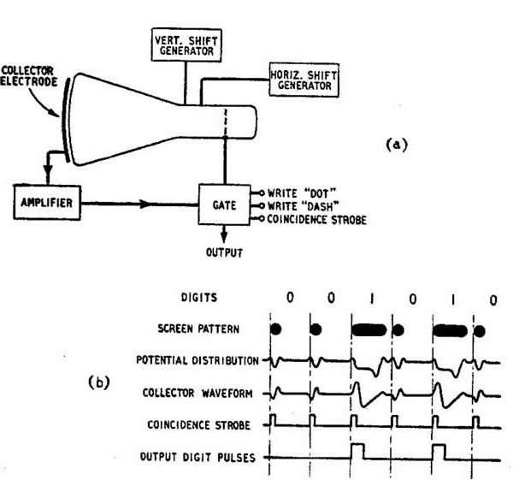
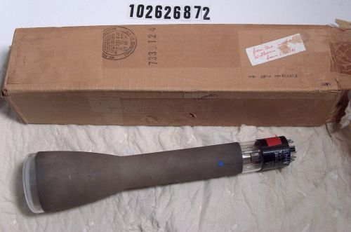
Add-On From This Week’s Lecture (2)
IBM 701 (circa 1952) uses Williams Tubes (electro-static tube memory):
‘In between’ vacuum tube technology and transistors for processing, moving and storing data.

Slide 4
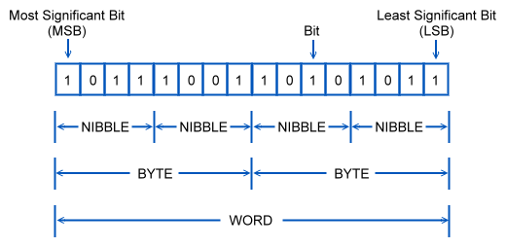
Add-On From This Week’s Lecture (3)
Bits, nibbles (or nybbles), bytes and words:
A ‘bit’ is a ‘binary digit’ – which can be 1 or 0

Slide 5
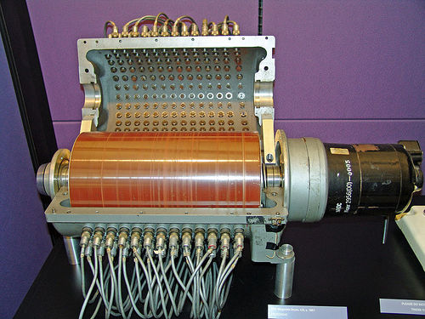
Add-On From This Week’s Lecture (4)
Magnetic drum:
The light brown surface had thousands of magnetisable spots – each one could represent 1 or 0

Slide 6
C-T-R Becomes IBM
Why?
What was IBMs vision?
Were there other companies ‘on the scene’?

Slide 7
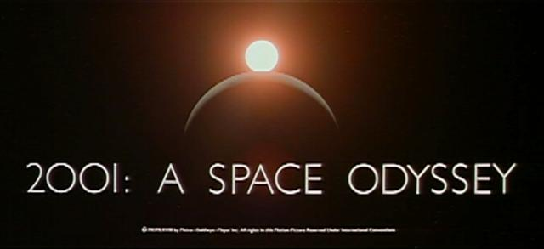
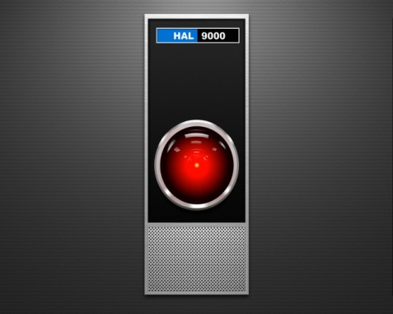
A B C D E F G H I J K L M N
A B C D E F G H I J K L M N
The HAL 9000

Slide 8
From Science to Commerce
Who are ‘Remington Rand’?
What was UNIVAC?

Slide 9
Microsoft?
The rise and rise of Microsoft
Is Bill Gates a genius?
“I can see a Mac out of my Windows(!)”

Slide 10
Intel – Chips with Everything
Intel – where did you come from?
AMD and others...
Any plans for tomorrow?

Slide 11
A Good History?
What can be learned from this look back at the evolution of IBM, Microsoft and Intel?

